Slide 1

51.516 Trustworthy AI
Fast Gradient Sign Method
(Evaluating Model Robustness
under Adversarial Perturbations)
Group No: 1
Charles Foo, Lee Kai Boo, Sagar Pratap Singh,
Sai Chin Kai (Clarence), Tan Ai Kun
22 May 2026
Notes:
The primary goal of this lab was not simply to achieve high model accuracy, but to investigate how reliable and trustworthy an AI system remains when exposed to adversarial manipulation.
In this experiment, we trained and evaluated a ResNet-18 image classifier using the CIFAR-10 dataset, and then generated adversarial examples using the Fast Gradient Sign Method, or FGSM.
This lab demonstrates an important lesson in Trustworthy AI: a model that performs well under normal conditions may still be highly vulnerable to carefully crafted perturbations.
We will walk through our experimental setup, attack methodology, robustness evaluation, and finally discuss the broader security, ethical, and governance implications of adversarial machine learning.”

Slide 2
Investigation Roadmap
Objective
Workflow
Experimentation Design
Clean Model Performance
Pre-Class Vulnerability Analysis
Confusion Matrix Under Attack
Trustworthy AI & Ethical Implications
Reflection
Dataset & Pre-Processing
Model Architecture & Training
Confidence Analysis
Conclusion

Slide 3
Objectives
Train and fine-tune a pretrained ResNet-18 on CIFAR-10 and MNIST
1
Evaluate clean image classification accuracy
2
Generate FGSM adversarial examples using IBM ART
3
Analyse robustness degradation under varying epsilon values
4
Investigate class-level adversarial vulnerability patterns
5
Compare adversarial behaviour across datasets with different feature complexity
6
Notes:
The primary goal of this lab was not simply to achieve high model accuracy, but to investigate how reliable and trustworthy an AI system remains when exposed to adversarial manipulation.
In this experiment, we trained and evaluated a ResNet-18 image classifier using the CIFAR-10 dataset, and then generated adversarial examples using the Fast Gradient Sign Method, or FGSM to evaluate how a fine-tuned ResNet-18 on CIFAR‑10 fails under FGSM attacks and whether model confidence is a usable safety signal.
This lab demonstrates an important lesson in Trustworthy AI: a model that performs well under normal conditions may still be highly vulnerable to carefully crafted perturbations.
We will walk through our experimental setup, attack methodology, robustness evaluation, and finally discuss the broader security, ethical, and governance implications of adversarial machine learning.

Slide 4
Workflow
Data Loading & Pre-Processing
1
Train model on baseline
2
FGSM Attack using epsilon sweep
3
Analysis & Visualisation
4
Reproducibility Setup
SEED = 42
torch.manual_seed(SEED)
np.random.seed(SEED)
random.seed(SEED)
torch.backends.cudnn.deterministic = True
torch.backends.cudnn.benchmark = False

Slide 5
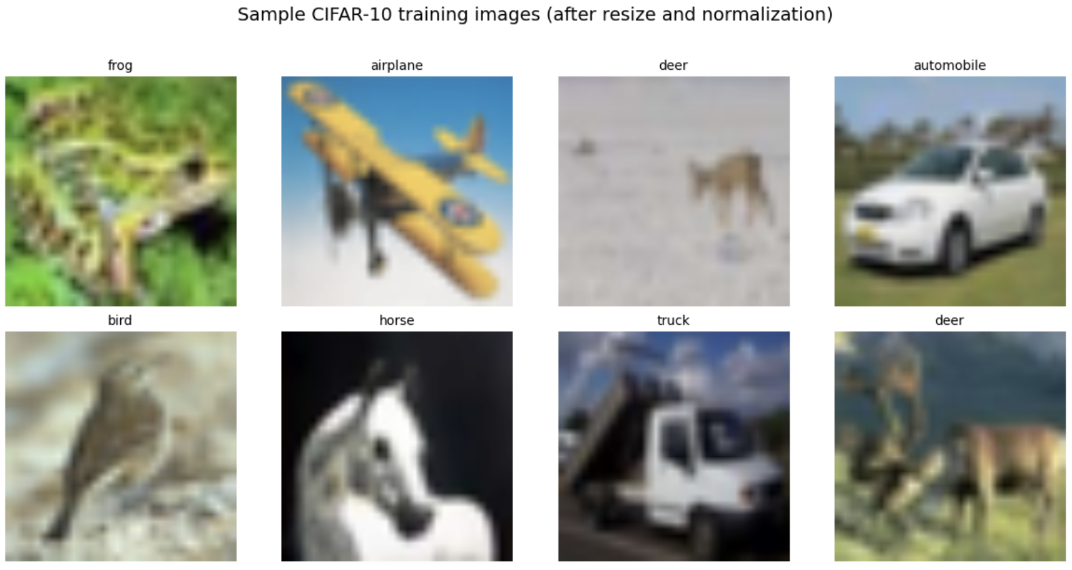
CIFAR-10 Data Samples
Sample images shown below are de-normalized for visualization. The model receives the normalized versions (ImageNet mean/std)
Notes:
Training converged rapidly due to transfer learning from ImageNet-pretrained weights. The model achieved 98.4% training accuracy and 94.14% clean test accuracy, indicating strong baseline feature learning prior to adversarial evaluation.

Slide 6
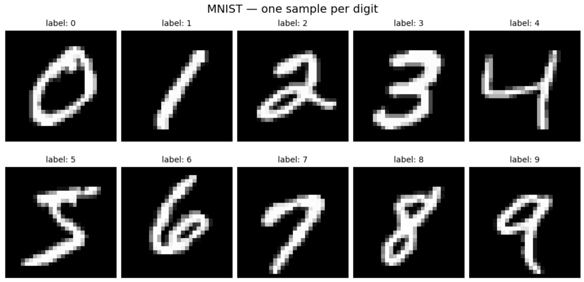
MNIST Data Samples
Sample images shown below pre-normalization

Slide 7
CIFAR-10 & MNIST Dataset & Preprocessing
 | CIFAR-10 | MNIST
Dataset type | 32x32 RGB images 10 object classes (airplane, car, etc.) | 28x28 Grayscale 10 -digit classes (0-9)
Size | 60,000 50k training, 10k test samples | 70,000 60k training, 10k test samples
Normalization | Normalized with ImageNet stats for stable training on pretrained ResNet
Channels | 3 (RGB) - ready | 1 (expand to 3 channels)
Batching | DataLoader mini-batches | DataLoader, batch_size 256
Code | transform = transforms.Compose([ Resize((224,224)), ToTensor(), Normalize(ImageNet mean/std) ]) | transform = Compose([ Grayscale(num_output_channels=3), ToTensor(), Normalize(ImageNet mean/std), ])

Slide 8
Model Architectures & Training
 | FT ResNet-18 on CIFAR-10 | FT ResNet-50 on MNIST
Backbone | ResNet-18 pretrained on ImageNet | ResNet-50 pretrained on ImageNet
Input Size | Resized to 224x224 | 28x28 (no resize – adaptive pooling)
FT Strategy | Replace FC layer, adapted to 10 class | Replace FC layer, adapted to 10 class
Trainable params | All 11.18M parameters are trainable during finetuning | 15M of 23.5M (Layer4 + FC)
Loss | CrossEntropy Loss
Optimizer | Adam (lr=0.001)
Epochs | 5 | 5
Code | model = resnet18(weights= ResNet18_Weights.DEFAULT) model.fc = nn.Linear(model.fc.in_features, 10) | Model = resnet50(weights= ResNet50_Weights.DEFAULT) model.fc = nn.Linear(model.fc.in_features, 10)
Notes:
For the model architecture, we used a pretrained ResNet-18 convolutional neural network. Instead of training from scratch, we applied transfer learning by modifying the final fully connected classification layer to support the 10 CIFAR-10 classes.
Transfer learning is beneficial because pretrained models already contain strong low-level feature extraction capabilities learned from large datasets. This reduces training time and computational cost while still achieving good performance.
The model was trained using CrossEntropyLoss as the loss function and the Adam optimizer for parameter updates.
The overall training workflow follows the standard deep learning pipeline:
prediction → loss calculation → gradient computation → weight update.
This stage establishes the clean baseline performance before introducing adversarial attacks.

Slide 9
Adversarial Attack Setup
Attack Mode: FGSM Epsilon Sweep
Objective: Investigate how attack strength impacts model robustness
Properties: White-box, Untargeted, Evasion, On-shot (single gradient step)
Step | Action | Task
1 | Wrap | Wrap fine-tuned model in ART's PyTorchClassifier with clip_values=(0,1)
2 | Extract | Extract test images as NumPy arrays in [0,1] pixel range, with their integer class labels, since ART operates on NumPy arrays
3 | Generate | Apply FGSM: x_adv = clip(x + ε·sign(∇ₓloss), 0, 1) — one ε-bounded gradient-sign step.
4 | Evaluate | Predict on x_adv, compare to true labels → adversarial accuracy vs. clean accuracy.
5 | Sweep | Repeat across ε values → accuracy-vs-ε curve, per-class heatmap, summary table.
ART Wrapper classifier = PyTorchClassifier(model=model, loss=criterion, optimizer=optimizer, input_shape=(3, 224, 224), nb_classes=10) | FGSM attack attack = FastGradientMethod(estimator=classifier, eps=epsilon, norm=np.inf )
The same FGSM attack setup and strategy was used for both fine-tuned models on CIFAR-10 and MNIST respectively
Notes:
FGSM computes the gradient of the loss function with respect to the input image and perturbs the image in the direction that maximally increases prediction error.
The epsilon sweep was designed to evaluate robustness across multiple attack strengths rather than relying on a single adversarial setting. Small epsilon values produce nearly imperceptible perturbations, while larger epsilon values increasingly distort the input distribution.
This experiment demonstrates that even visually negligible perturbations can significantly degrade neural network performance, revealing the fragility of learned decision boundaries.

Slide 10
CIFAR-10
Training results, Clean Accuracy, Adversarial attack setup & results

Slide 11
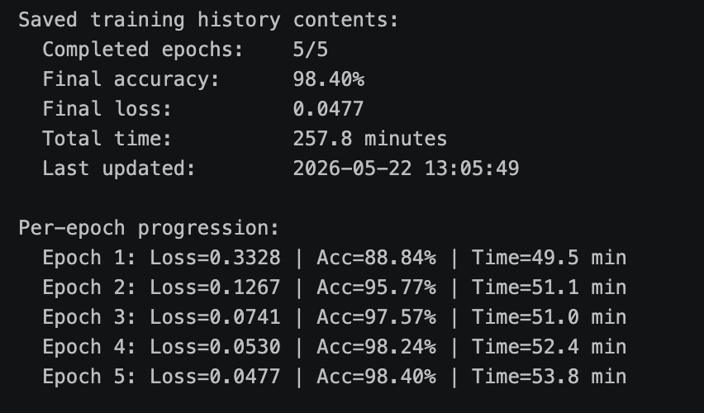
Training Results
Notes:
For the model architecture, we used a pretrained ResNet-18 convolutional neural network. Instead of training from scratch, we applied transfer learning by modifying the final fully connected classification layer to support the 10 CIFAR-10 classes.
Transfer learning is beneficial because pretrained models already contain strong low-level feature extraction capabilities learned from large datasets. This reduces training time and computational cost while still achieving good performance.
The model was trained using CrossEntropyLoss as the loss function and the Adam optimizer for parameter updates.
The overall training workflow follows the standard deep learning pipeline:
prediction → loss calculation → gradient computation → weight update.
This stage establishes the clean baseline performance before introducing adversarial attacks.”

Slide 12
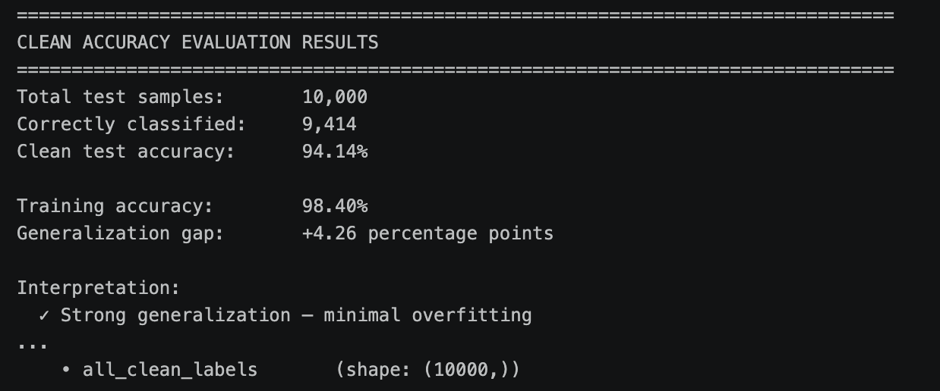
Clean Model Performance
Clean Accuracy Evaluation measured on the original, unperturbed test set provides the baseline classification accuracy of the model under normal operating conditions.
CIFAR-10 achieved a high clean accuracy of 94.14%
Notes:
Before performing adversarial attacks, we first evaluated the model using clean, unmodified test images. This provides the baseline classification accuracy of the model under normal operating conditions. As shown in the results, the model achieved relatively high clean accuracy, indicating that it learned meaningful visual patterns from the dataset.
However, one of the major lessons in Trustworthy AI is that high clean accuracy alone does not guarantee robustness or reliability.
A model may perform extremely well under normal conditions but still fail catastrophically when exposed to adversarial perturbations.
This motivates the need for adversarial robustness testing beyond conventional accuracy metrics and illustrates a common limitation of benchmark-driven evaluation, i.e. high clean accuracy can mask severe robustness vulnerabilities under adversarial conditions.

Slide 13
FGSM Attack using IBM ART
FGSM Attack – Epsilon Sweep Experimentation
Investigate how attack strength affects model robustness.
Accuracy degraded progressively as epsilon increased.
Epsilon | Impact | Result Interpretation
0.00 | None | No attack (sanity check)
0.01 | None | Imperceptible noise floor
0.03 | Negligible | Goodfellow regime — typical literature value
0.05 | Barely Visible | Mild perturbation
0.10 | Slightly Visible | Moderate
0.15 | Visible | Visible
0.20 | Clear Noise | Strongly Visible
0.30 | Obvious Noise | Heavy Perturbation
Notes:
Methodological Design:
1. Same test set across all epsilons for direct comparability
2. Same model, same seed for reproducibility
3. Per-epsilon checkpointing for partial results to be saved to disk after each ε
4. Resume-capable so that interrupted sweeps can continue from last completed ε
5. Only predictions saved, adversarial images discarded between epsilons (memory + disk efficiency
6. ε=0.1 reused eliminates redundant compute
These controls were implemented to ensure that observed behavioural changes were attributable to attack strength rather than randomness, data variation, or execution inconsistencies.
Our expectation:
1. ε=0.0: adversarial accuracy ≈ clean accuracy (94.14%) — pipeline sanity check
2. ε ↑: monotonic decrease in adversarial accuracy
3. Curve shape reveals decision-boundary geometry: sharp drops = fragile in many directions

Slide 14
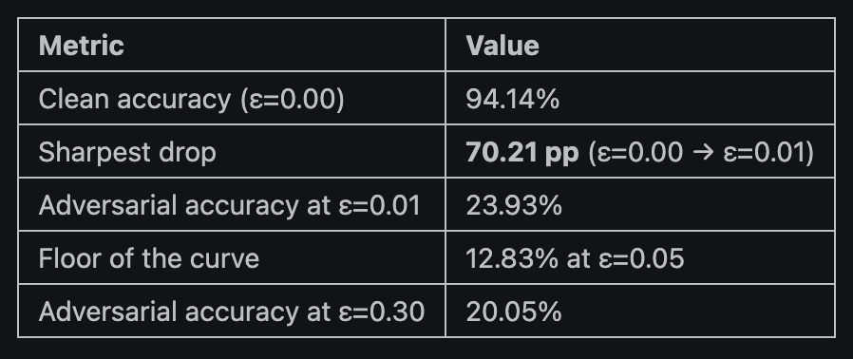
Experimentation Design
Epsilon Sweep Experimentation – Interpretation of Results
An imperceptible perturbation (ε=0.01, ~1% of pixel range) collapses the model from 94.14% to 23.93% accuracy, i.e. a 70% drop induced by noise no human observer would detect.
Notes:
The adversarial accuracy curve exhibited non-monotonic behaviour, bottoming out at ε=0.05 before partially recovering at higher epsilon values.
This reflects two FGSM limitations:
Breakdown of the local linear approximation at large ε
Out-of-distribution effects where perturbed inputs no longer resemble realistic samples
Interestingly, the most damaging perturbations were also the least visually detectable, demonstrating that human inspection alone is not a reliable defence against adversarial attacks.
These findings show that robustness evaluation must consider multiple attack regimes rather than a single epsilon benchmark.

Slide 15
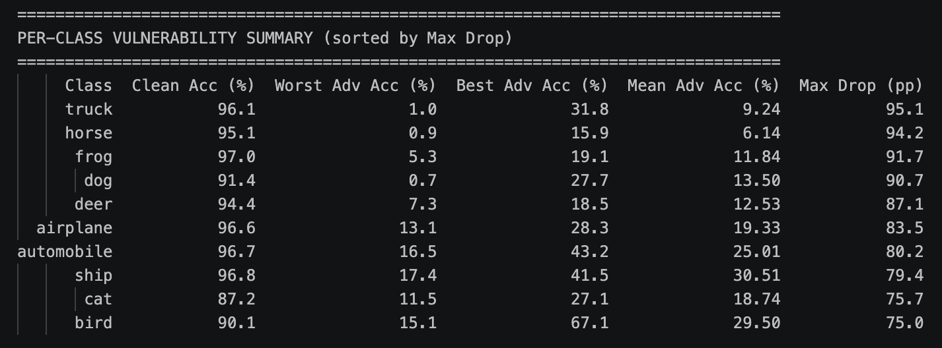
Per-Class Vulnerability Analysis
Equal distribution of 1000 samples per class.
The 3 most vulnerable classes identified are:
Truck, Horse, Frog (drop of 95.1%, 94.2% and 91.7% respectively)
The 3 most robust classes are:
Bird, Cat, Ship (drop of 75%, 75.7% and 79.4% respectively)
Finding: Model vulnerability is class-dependent rather than uniformly distributed.
Notes:
In addition to overall accuracy degradation, we also analysed whether certain image classes were more vulnerable to adversarial attacks.
Our observations suggest that adversarial vulnerability is not uniformly distributed across classes. Some classes degraded much more rapidly than others as epsilon increased. We also observed cases where adversarial examples were repeatedly misclassified into specific ‘attractor classes.’
This suggests that the model’s learned feature representations are unevenly distributed.
Certain classes may possess weaker or less separable feature boundaries, making them more susceptible to adversarial manipulation.
This finding is important because it reveals that robustness is not simply a global model property. Instead, vulnerability can vary depending on feature complexity, class similarity, and training distribution. Such behaviour may also expose hidden biases and weaknesses in the learned representation space.
Why class-level analysis matters.
Aggregate accuracy masked substantial differences between classes. Per-class analysis revealed that robustness vulnerabilities were unevenly distributed across the feature space.

Slide 16
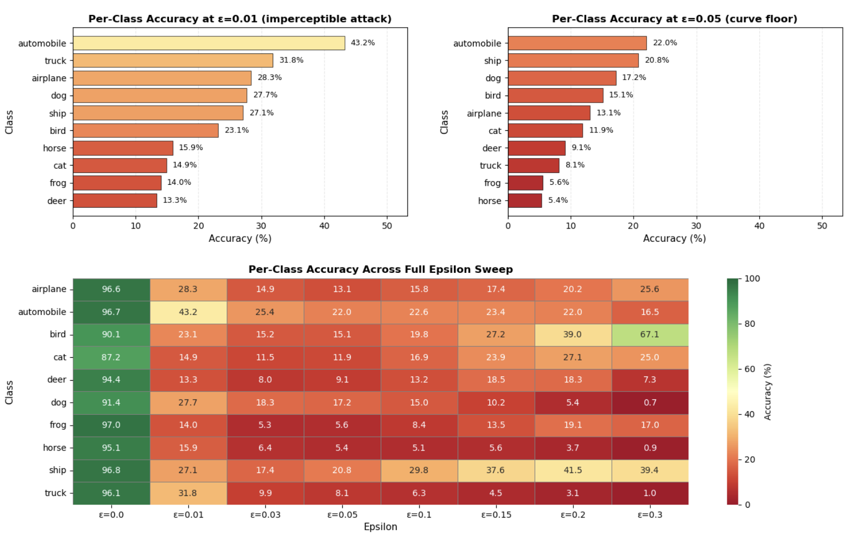
Per-Class Vulnerability Analysis
Notes:
The heatmap revealed that adversarial vulnerability was unevenly distributed across classes and attack strengths.
Some classes remained consistently fragile across the epsilon sweep, while others exhibited non-monotonic recovery patterns linked to attractor-class behaviour.
This demonstrates that aggregate accuracy can mask important class-level robustness differences and that adversarial failure may reflect weaknesses in the model’s learned feature geometry rather than uniform degradation.

Slide 17
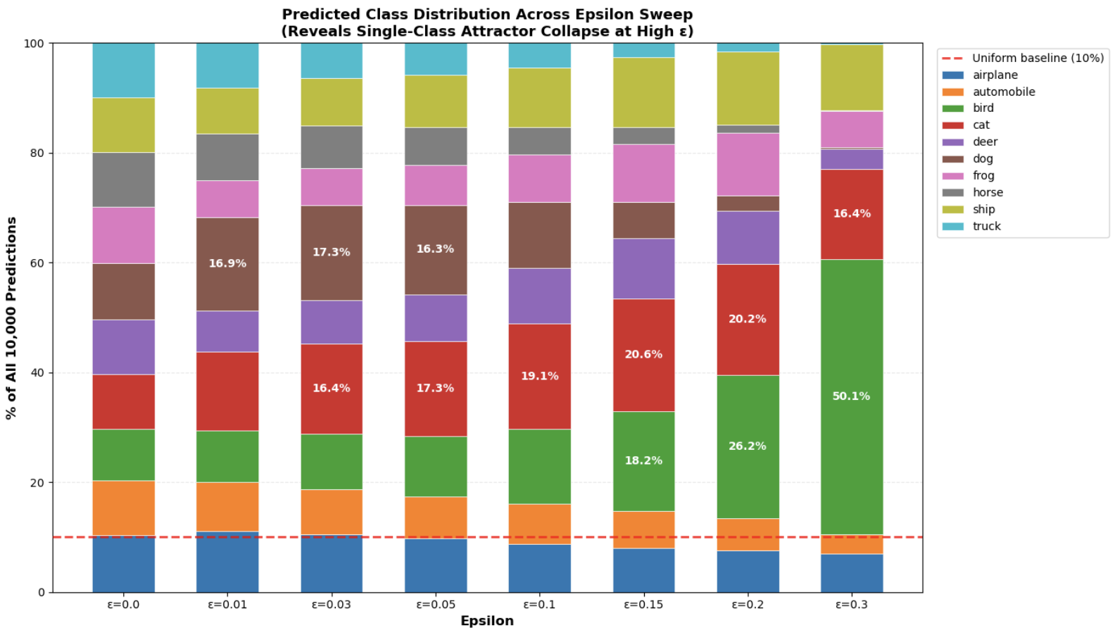
Per-Class Vulnerability Analysis
The Single-Class Attractor Collapse Phenomenon - model is predicting "bird" for half of all images at ε=0.3
Notes:
The model is predicting "bird" for half of all images at ε=0.3.
Six of ten classes are functionally extinct in the output distribution. This is not "predictions becoming random" (which would give ≈10% per class). It is single-class attractor collapse.
This finding has two consequences:
1. Bird's apparent recovery to 67.1% accuracy is largely artefactual. Its precision is only 13.4% (671 actual birds / 5,010 "bird" predictions). The model is not accurately identifying birds; it is defaulting to "bird" and accidentally getting some right.
2. The deployment-governance implication is more severe than the aggregate curve suggested: a model that fails by collapsing to a known attractor class fails *predictably and exploitably, not randomly.
The cell below visualises how the prediction distribution evolves across the full epsilon sweep, making the emergence of the attractor class explicit.
The model did not become uniformly uncertain under attack. Instead, its predictions collapsed into a highly structured and biased output distribution.

Slide 18
Per-Class Vulnerability Analysis
Insights:
Adversarial attacks do not cause random failure. They expose structured weaknesses in the model’s learned feature space.
Animal Classes Were More Fragile Under Small Attacks
Robustness Depends on Attack Strength
Model Failure Was Structured, Not Random
Aggregate Accuracy Hid Important Behaviour
Deployment Implications
Notes:
These findings show that adversarial failure was structured, class-dependent, and attack-regime sensitive rather than random.
Low-epsilon attacks primarily amplified existing weak decision boundaries between visually similar animal classes, while stronger perturbations triggered attractor-class collapse toward “bird.”
The apparent recovery in aggregate accuracy at high ε was therefore not genuine robustness, but a consequence of biased prediction collapse.
This highlights the importance of behavioural analysis beyond aggregate accuracy metrics in Trustworthy AI evaluation.

Slide 19
Confusion Matrix Under Attack
To verify if adversarial failure was structured rather than random.
Attack Regime | Dominant Behaviour
Low ε | Local Semantic Confusion
High ε | Global Attractor Collapse
Adversarial attacks exposed structured weaknesses in the model’s learned feature space rather than causing purely random failure.
Notes:
Confusion matrices helped verify that adversarial failure was structured rather than random.
At low epsilon values, errors were concentrated between visually similar animal classes such as cat, dog, deer, and horse, indicating that FGSM amplified existing weak decision boundaries.
At high epsilon values, the failure pattern shifted dramatically. Predictions from nearly all classes increasingly collapsed toward the bird class, showing a global attractor effect under strong perturbations.
This demonstrates that different attack strengths produce different failure geometries:
low epsilon causes local semantic confusion,
while high epsilon causes large-scale feature-space collapse.
These findings also suggest that predictable attractor behaviour could both create exploitable vulnerabilities and provide opportunities for deployment-time anomaly detection.
Confusion matrices were used to verify whether the attractor-class behaviour observed earlier reflected genuine prediction drift patterns rather than aggregate statistical artefacts.

Slide 20
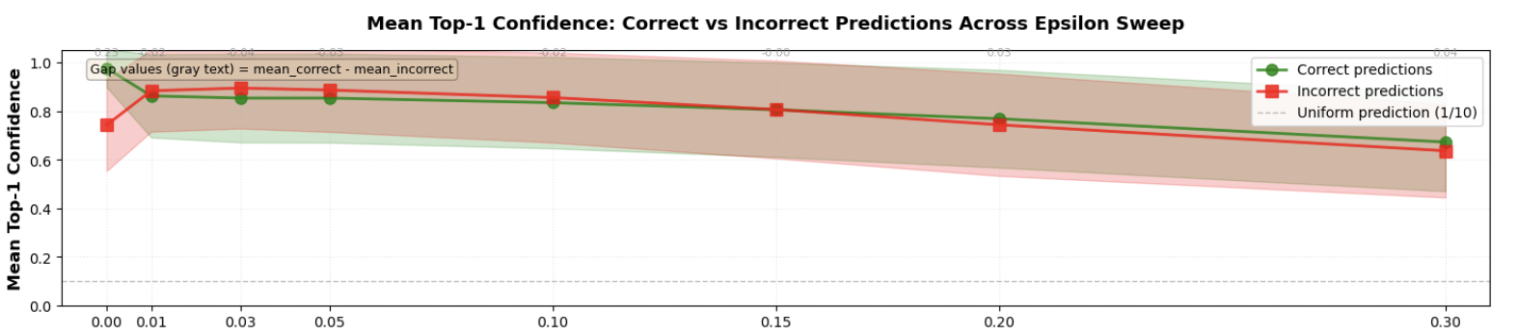
Confidence Analysis
Is confidence a usable safety signal?
Confidence trajectory:
GREEN line (correct predictions) staying high indicates that model is confident when right
RED line (incorrect predictions) staying high indicates that model is confidently WRONG
Lines converging or crossing = confidence cannot discriminate
The 'uniform' line at 0.10 is the chance-level confidence floor
Notes:
Clean confidence is well-calibrated; under attack it is destroyed.
At ε=0.0, correct predictions have mean confidence 0.976 vs. 0.742 for incorrect.
A 0.23 gap that makes confidence thresholding a usable safety signal.
At ε=0.01, the gap collapses to −0.021, where incorrect predictions are more confident (mean 0.883) than correct ones (0.862).

Slide 21
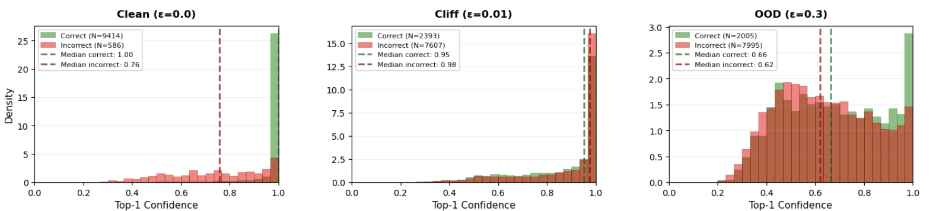
Confidence Analysis
Distribution overlap:
Distributions far apart = confidence is a usable signal
Distributions overlapping = confidence is useless as a signal
Compare clean (left) to attack regimes (middle, right)
Notes:
The cliff inversion is a structural consequence of FGSM.
Cross-entropy loss is maximised by high-confidence wrong predictions; FGSM optimises for exactly this. Any standard classifier under FGSM at the cliff regime will exhibit similar confidence inversion. It is not a quirk of this model.

Slide 22
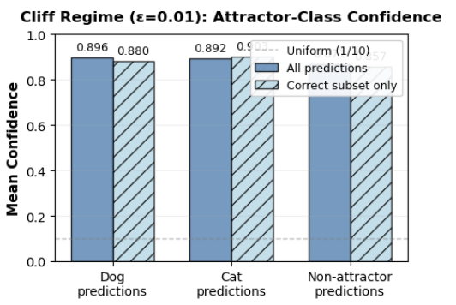
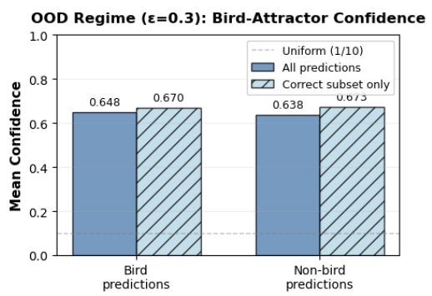
Confidence Analysis
Attractor Confidence:
High attractor-prediction confidence = model is confidently fallen into the attractor class
Low confidence on attractor predictions = model is at least signalling uncertainty during collapse
Notes:
Attractor predictions are made with the highest confidence.
At ε=0.01, dog predictions average 0.896 confidence (16% precision) and cat 0.892 (10% precision), versus 0.71 for non-attractor predictions. The model collapses into the attractors *confidently* — exactly when it is most wrong.
This behaviour is particularly dangerous in deployment because confidence-based filtering or human review systems may incorrectly trust highly confident adversarial outputs.

Slide 23
MNIST
Training results, Clean Accuracy, Adversarial attack setup & results

Slide 24
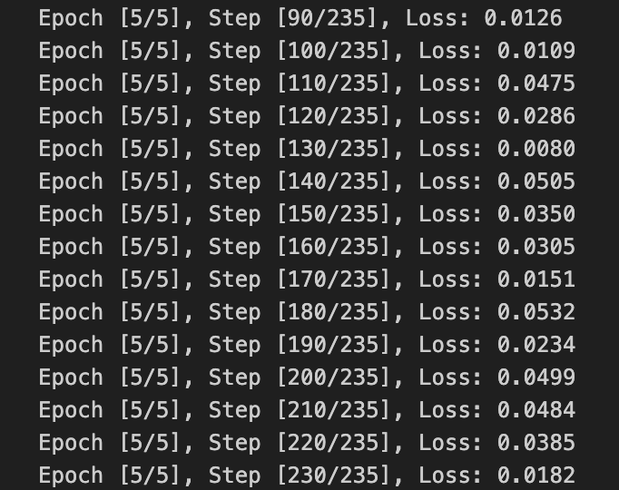
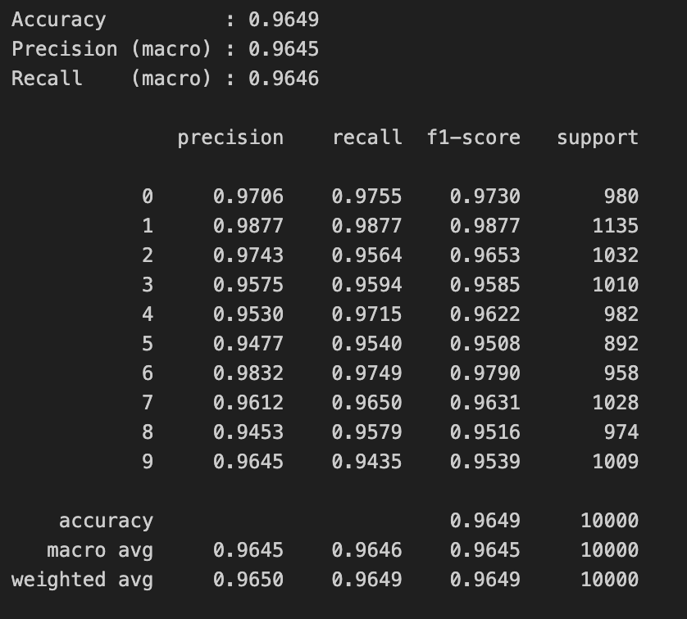
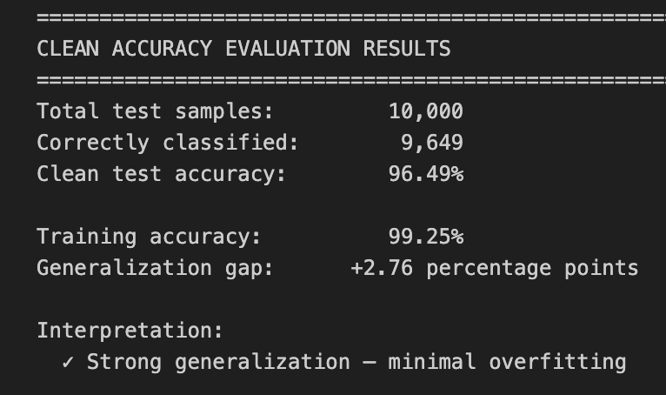
Training Results
Notes:
Training loss dropped from 1.53 to 0.10 within the first epoch and settled around 0.01-0.05 by epochs 3-5. By epoch 3, the model had essentially converged, any additional epochs yielded little benefit
Final Results
Training Accuracy 99.25%
Test Accuracy 96.49%
Generalization 2.76 pp
Model generalized well to the MNIST digits instead of memorizing, given that we froze most of the backbone and only fine-tuned layer 4 + head (~15M parameters out of 23.5M)- this limits the model’s capacity to overfit

Slide 25
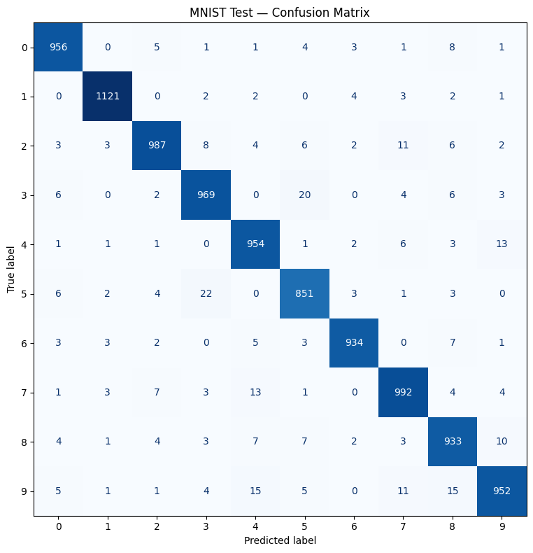
Clean Model Performance
Metrics
Precision 0.9645
Recall 0.9646
F1 Score 0.9649
Per-class Accuracy
Strongest on visually distinct digits
1 – F1 0.988,
6 – F1 0.979
Relatively weaker on classically confusable ones
8 – F1 0.952
5 – F1 0.951
9 – F1 0.954

Slide 26
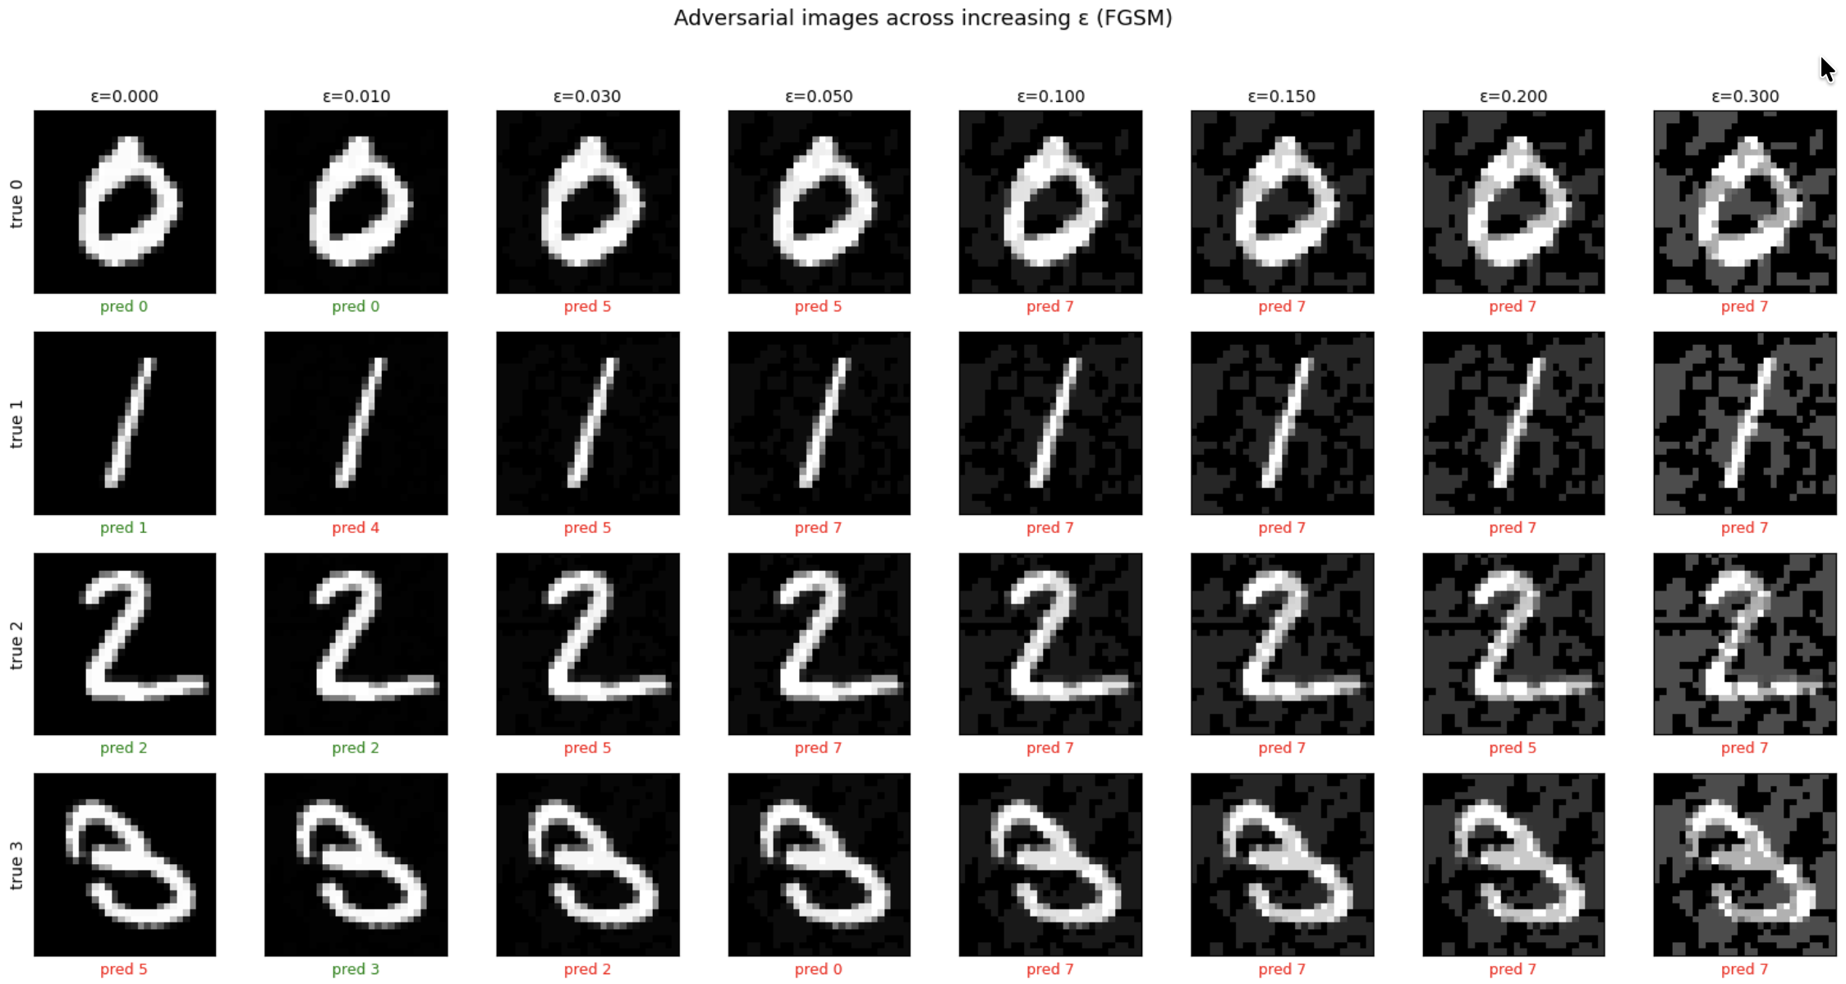
FGSM Attack- MNIST Adversarial Images
At epsilon values 0.01 and 0.03, the adversarial noise added is highly imperceptible to the naked eye
Notes:
As the value of epsilon was varied incrementally from 0.01 onwards, the adversarial noise in the image became more perceptible to the human eye. At e=0.01, accuracy dropped to 64.3%, while the best adversarial

Slide 27
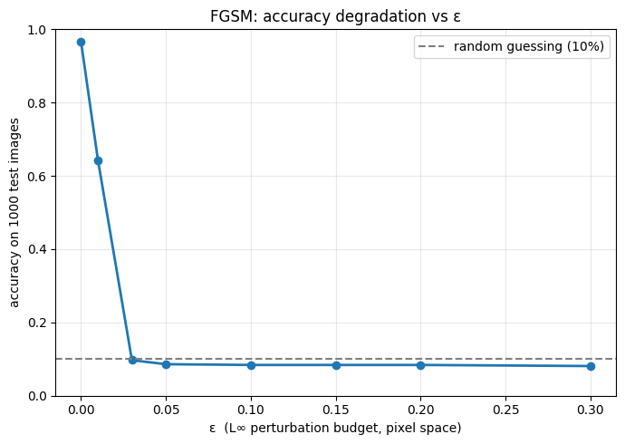
Accuracy degradation with epsilon variation
Notes:
At epsilon=0.01, the model has partially degraded from accuracy of 96.49% to 64.3% . Visually, this attack is the most imperceptible to the human eye.
At epsilon=0.03, the model has completely degraded to <10% accuracy (9.7%). At this epsilon, the model is essentially guessing the digit class. Visually, this attack also remains imperceptible, yet this is also the curve floor, further epsilon variations beyond 0.03 do not degrade the accuracy further- flattening ~ 8%

Slide 28
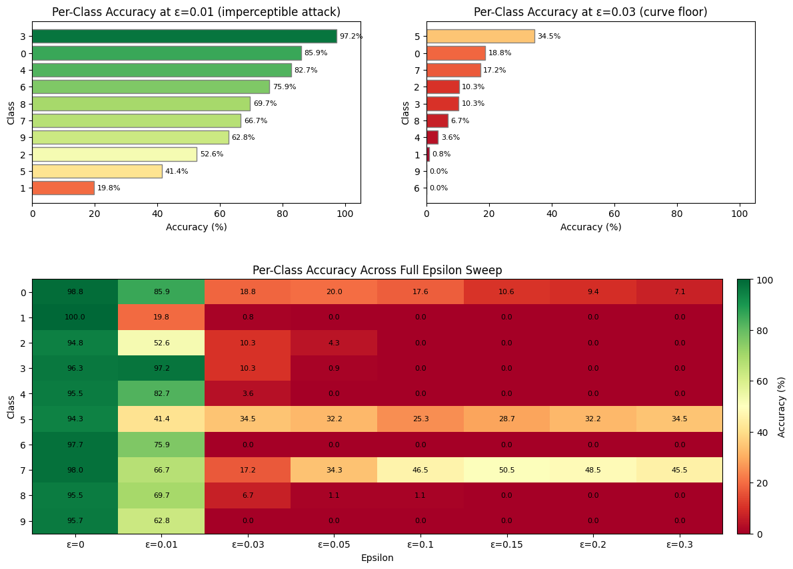
Per-Class Vulnerability Analysis (MNIST)
Notes:
Analysis
At e=0.01, average accuracy 64.3%, but with varying accuracy per digit. Structurally distinct digits like 3 and 0 resist adversarial attack and maintain accuracy at 97.2% and 85.9% respectively. Digit 1 is most affected with the adversarial attack given single stroke pattern, a slight gradient-nudge pushes it across a boundary to visually similar classes like 7,2.
At e=0.03, most digits are sub 20% accuracy, digits 9 and 6 are already at 0%. Only digit 5 retains some accuracy (34.5%) – but that’s attributed to a herding effect of other misclassifications converging (see c)
Beyond e=0.03, while the aggregated accuracy is flat, the per-class accuracy shows two striking behaviors: i) Digits 5 and 7 retain/increase in accuracy (34.5% and 45.5% respectively) as more adversarial noise is added. This is not a signal of robustness yet this is because the attack herds the whole dataset to these digits. The heatmap is plotting recall, and recall(7) rises because the model now predicts "7" for almost everything, it also predicts "7" for most of the actual 7s. Likewise for 5. Precision on the other hand is low since most of these 5s and 7s are not true positives.

Slide 29
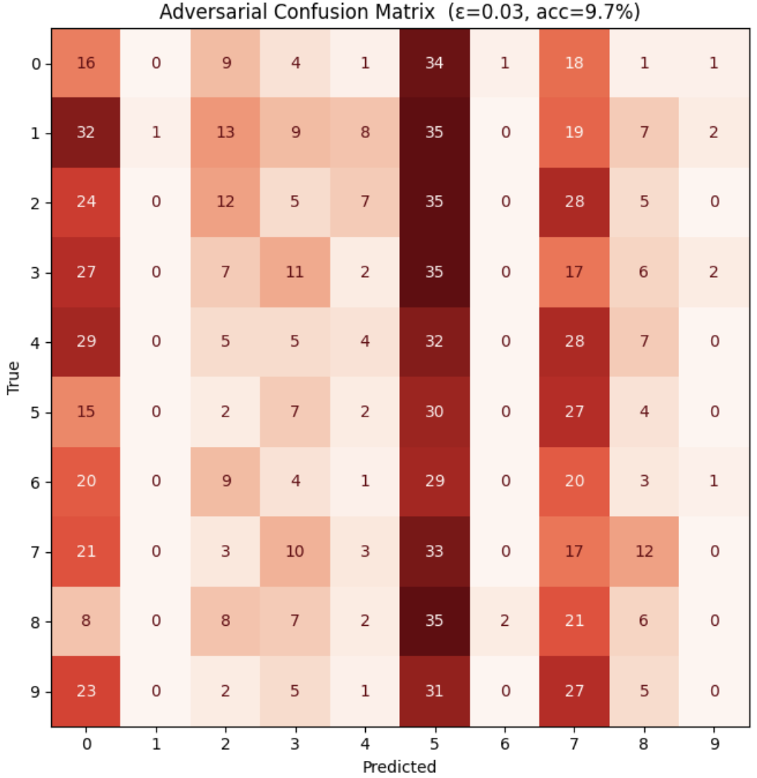
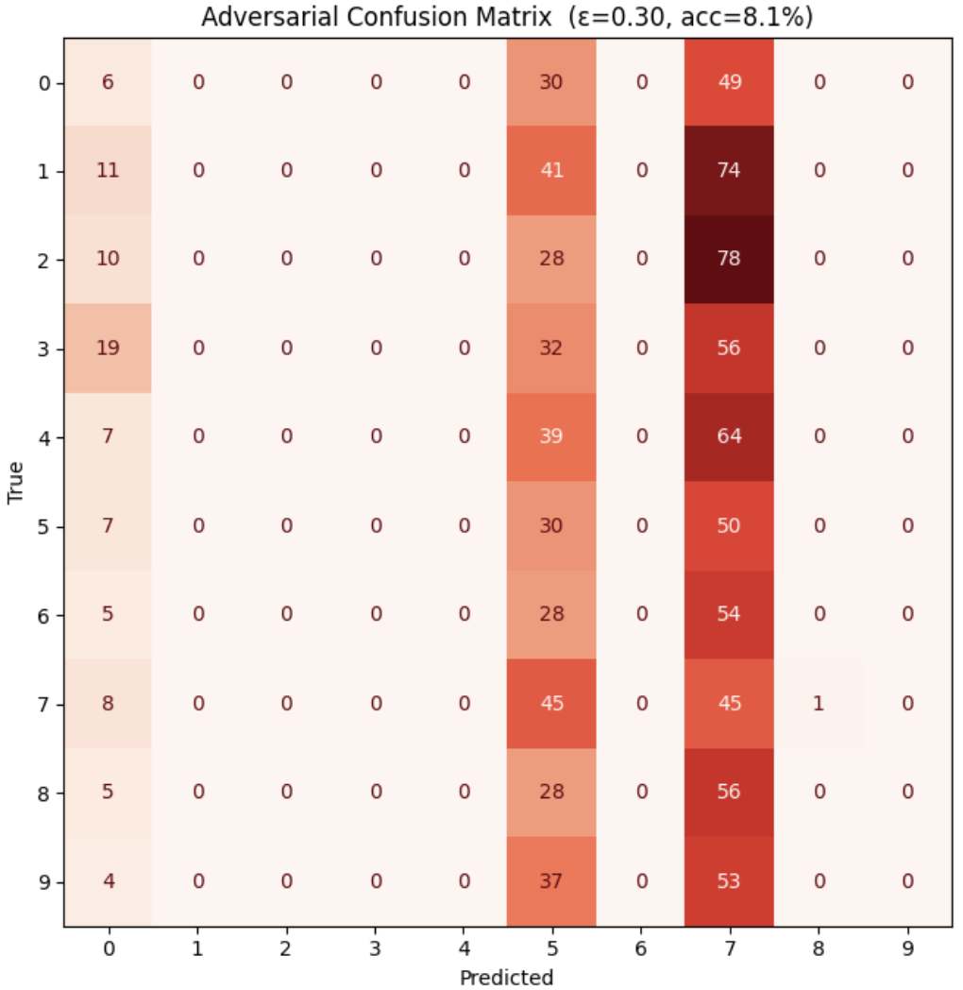
Adversarial Confusion Matrix at e=0.03/0.3
At e=0.03 the model accuracy has reduced to ‘guessing’ (9.7%)
The ‘herding’ effect increases as epsilon increases from 0.03 to 0.3, where all predictions converge to 5 or 7
Notes:
Analysis
At e=0.01, average accuracy 64.3%, but with varying accuracy per digit. Structurally distinct digits like 3 and 0 resist adversarial attack and maintain accuracy at 97.2% and 85.9% respectively. Digit 1 is most affected with the adversarial attack given single stroke pattern, a slight gradient-nudge pushes it across a boundary to visually similar classes like 7,2.
At e=0.03, most digits are sub 20% accuracy, digits 9 and 6 are already at 0%. Only digit 5 retains some accuracy (34.5%) – but that’s attributed to a herding effect of other misclassifications converging (see c)
Beyond e=0.03, while the aggregated accuracy is flat, the per-class accuracy shows two striking behaviors. (i) Most of the digits fall to 0% accuracy (ii) Digits 5 and 7 retain/increase in accuracy (34.5% and 45.5% respectively) as more adversarial noise is added. This is not a signal of robustness yet this is because the attack herds the whole dataset to these digits (Attractor classes). The heatmap is plotting recall, and recall(7) rises because the model now predicts "7" for almost everything, it also predicts "7" for most of the actual 7s. Likewise for 5. Precision on the other hand is low since most of these 5s and 7s are not true positives.

Slide 30
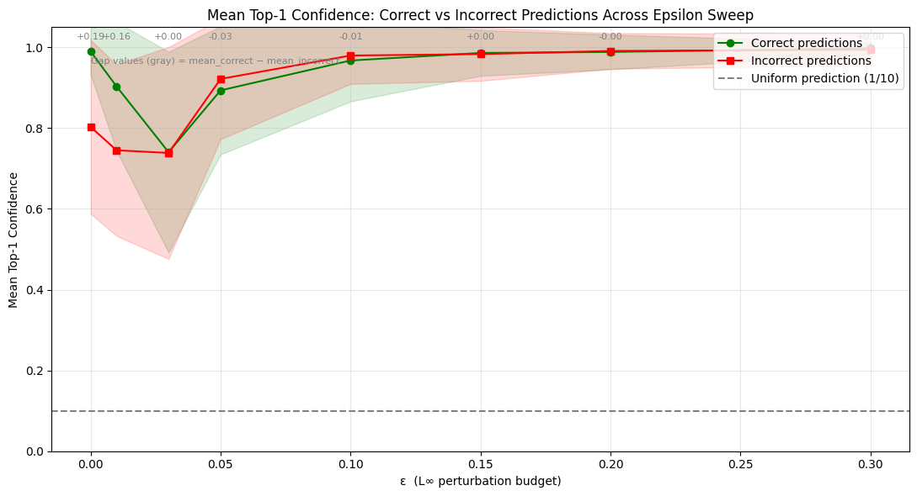
Confidence Analysis
Model stays 74–100% confident even as accuracy collapses to ~8% , so it's confidently wrong. Confidence is not a usable safety signal against adversarial attack
Notes:
1. Confidence always between 74-100%, the model is always confident — even when its accuracy is ~8%
2. The confidence gap vanishes at e=0.03, then inverts. This implies that beyond e=0.03, the model’s incorrect predictions have a higher confidence than correct predictions.
3. At extreme ε=0.3, the model is ~99% confident and ~92% wrong. This is the worst possible combination for a confidence-threshold defense against adversarial attack

Slide 31
INSIGHTS & REFLECTIONS

Slide 32
Trustworthy AI & Ethical Implications
Trustworthy AI requires not only performance, but also robustness, transparency, accountability, and continuous security evaluation.
Technical Implications
High clean accuracy is insufficient for trustworthy deployment.
AI systems can fail under adversarial manipulation.
Robustness testing should be part of deployment pipelines.
Continuous monitoring and red teaming are important.
Ethical & Societal Implications
Adversarial attacks may threaten human safety.
Fragile AI systems may erode public trust.
Organisations remain accountable for insufficient robustness testing.
Adversarial techniques may be weaponized by malicious actors.
Real-World Examples include but not limited to autonomous vehicles, medical diagnosis systems, facial recognition systems
Notes:
Our findings demonstrate that high clean accuracy alone is insufficient for trustworthy AI deployment. Under adversarial perturbation, the model failed confidently, predictably, and in exploitable ways.
From a technical perspective, this reinforces the need for robustness testing, red teaming, and behavioural monitoring throughout the deployment lifecycle.
From an ethical and governance perspective, adversarial vulnerabilities may threaten safety, erode public trust, and expose organisations to accountability risks in high-stakes AI systems such as autonomous vehicles, healthcare, and facial recognition.
Trustworthy AI therefore requires not only performance, but also robustness, transparency, accountability, and continuous security evaluation.

Slide 33
Conclusion
Key Findings to our Research Questions
Questions | Key Findings
How does FGSM affect robustness? | Small perturbations caused severe accuracy collapse.
Are vulnerabilities uniformly distributed? | No — animal classes were significantly more fragile. Same with MNIST where digit 1 was extremely fragile
Does the model fail randomly? | No — failure was structured around attractor classes.
Is confidence a reliable safety signal? | No — the model became confidently wrong under attack.
Does dataset complexity influence adversarial behaviour? | Yes — vulnerability patterns differed significantly between CIFAR-10 and MNIST.
Why this matters:
Cross-dataset comparison suggests that adversarial vulnerability patterns depend strongly on dataset complexity and feature-space structure.
The danger is not merely that the model becomes inaccurate, but that it fails confidently, predictably, and in exploitable ways.
Notes:
To conclude, our experiments demonstrated that the pretrained ResNet-18 model achieved strong clean accuracy on the CIFAR-10 dataset.
However, the FGSM adversarial attack significantly degraded model performance as epsilon increased. We also observed that adversarial vulnerability varied across image classes and that confidence alone was not a reliable indicator of correctness.
These findings reinforce an important principle of Trustworthy AI.
A model that performs well under ideal conditions may still behave unpredictably under adversarial manipulation. Therefore, trustworthy deployment requires more than benchmark accuracy. It requires robustness evaluation, security testing, explainability, governance, and continuous monitoring. Ultimately, this lab demonstrates why adversarial robustness is an essential component of responsible AI deployment.”

Slide 34
Reflection
Team Member | Reflections (Include real-world implications, limitations, risks, ethics, and lessons learned)
Charles Foo | We cannot determine whether a model is safe to deploy by looking at its standard metrics. The properties that matter for deployment (ie. robustness to adversarial inputs, calibrated confidence, class failures etc.) are not visible at the headline accuracy number. In our case example: The model passes normal evaluation The attack is mathematically simple The perturbation is invisible The failure is severe Standard intuition about “robust model” don’t help We need to ensure our projects teams and vendors teams consider consider adversarial defenses when designing and deployment models as the implications of not doing so is very high e.g. autonomous vehicles, medical, financial decisioning, digital identification. Furthermore, standard “robustness” accuracy metrics may not be sufficient and deployment scenarios specific robustness metrics should be considered We should also be more mindful when deciding to use open-source models (out of the box) and open-source datasets as these are likely to be “easy” adversarial targets.

Slide 35
Reflection
Team Member | Reflections (Include real-world implications, limitations, risks, ethics, and lessons learned)
Lee Kai Boo | What struck me most during the epsilon sweep was not how quickly the model failed — but that I could barely see why. Even at ε = 0.30, where accuracy had collapsed toward random-guess levels, the digits still looked like digits to me. This reveals something more unsettling than a technical flaw: humans and neural networks are not solving the same recognition problem. We interpret images through shape, context, and lived meaning, while models learn statistical patterns in high-dimensional pixel space — exactly what FGSM silently corrupts. This asymmetry becomes life-threatening in the real world. A physically tampered stop sign, carrying adversarial-like perturbations through stickers or graffiti, could appear completely normal to a pedestrian or traffic officer while causing an autonomous vehicle to misclassify it and keep driving — with fatal consequences. Ironically, this is precisely where human-in-the-loop oversight matters most: not as a bureaucratic checkpoint, but as a semantically grounded second perspective that catches what gradient-trained models are structurally blind to.

Slide 36
Reflection
Team Member | Reflections (Include real-world implications, limitations, risks, ethics, and lessons learned)
Sagar Pratap Singh | Achieving a high accuracy on test samples with strong generalization is not a ready-signal for production deployment. The risk of FGSM attacks on model is real, especially given this is an evasion attack that can also work in black-box mode (transferred from a surrogate model in production), so an attacker does not need to know the model weights, just similar enough data. The risk is amplified by the fact that addition of adversarial noise are visibly imperceptible to the human eye, while still collapsing a 96% accurate model to 9%. Moreover, confidence threshold cannot be used to trust model’s output, we have observed that under adversarial attack, the model continues to make incorrect predictions with high accuracy. Extending the MNIST model to the real-world, the dangers of such adversarial attacks on models that are trained to recognized digits are significant. They can cause big money frauds in banking systems (bank cheque processing), evading traffic surveillance tracking license plates, and the same vulnerability extends to higher stakes environment where facial recognition, autonomous vehicles operate. It is important to implement defensive strategies against both black-box and white-box attacks. For example, the FGSM adversarial samples can be used to retrain the model. The caveat remains that the model overfits to FGSM attacks and will not be immune to other adversarial attacks. Other defensive mechanisms could be input validation or human-in-the-loop (Based on FGSM attack on ResNet-50 MNIST)

Slide 37
Reflection
Team Member | Reflections (Include real-world implications, limitations, risks, ethics, and lessons learned)
Sai Chin Kai (Clarence) | It was surprising how easily the model failed even when the changes were invisible to humans. A very small change caused accuracy to drop sharply. As the attack strength increased, performance did not fall in a smooth, predictable way and sometimes even briefly improved before getting much worse. This shows that testing only one level of attack can be misleading, and that high accuracy in normal conditions does not guarantee reliability in real-world use. The results also showed large differences in performance across classes. Some classes were heavily affected, while others were more stable. Under stronger attacks, the model stopped spreading its predictions across classes and instead collapsed into predicting a single label for most inputs, leading to very unbalanced performance and near-total failure for some classes. Confidence scores also became unreliable under attack. The model was more confident in its wrong predictions than in its correct ones. This shows that confidence alone is not a trustworthy indicator of correctness. Overall, the lab highlights that models must be evaluated not just on accuracy under normal conditions, but on how they behave and fail under stress.

Slide 38
Reflection
Team Member | Reflections (Include real-world implications, limitations, risks, ethics, and lessons learned)
Tan Ai Kun | It was a surprising insight to witness how easily the model collapsed under imperceptible perturbations. This lab made me realize that benchmark performance alone can mask significant operational fragility, and reinforced the importance of evaluating AI systems under abnormal and adversarial conditions rather than only ideal test scenarios. What was even more striking was how the model could become confidently wrong under attack. This raises serious concerns about relying solely on confidence metrics as a trust signal without additional validation, monitoring, or governance mechanisms. Prior to this lab, I had expected adversarial attacks to result in largely random degradation. Instead, the team observed predictable attractor-class collapse, where the model repeatedly defaulted to specific classes under attack. Such predictable failure behaviour could potentially be exploited by attackers in real-world deployments. At the same time, it also highlighted how behavioural monitoring and anomaly detection may serve as important ongoing operational controls. Another observation was that humans could still correctly recognize images that fooled the model. This made me question how much current AI systems truly “understand” compared to how much they rely on fragile statistical patterns learned from training data. I learned that Trustworthy AI is not only about building accurate models. It is equally about understanding how systems fail, when they fail, whether humans are able to detect those failures, and how organizations remain accountable when failures occur. Similar to enterprise systems, robustness and operational resilience matter just as much as functionality.

Slide 39
References
1. Goodfellow, I., Shlens, J., & Szegedy, C. (2015). Explaining and harnessing adversarial examples. International Conference on Learning Representations (ICLR). ICLR Paper
2. ChatGPT. (2026, May 22). Generated Python code and debugging support for FGSM adversarial attack labs using PyTorch. OpenAI. ChatGPT

